Slide 1

AASD 4000
Machine Learning - I
Applied AI Solutions Developer Program

Slide 2
Module 04 Pandas Tutorial
Vejey Gandyer

Slide 3
Agenda
Installing and Running Pandas
Pandas Objects
Data Indexing and Selection
Missing Data
Combining Datasets
Aggregation and Grouping
Pivot Tables
Strings
Files
Task: Covid Data Analysis

Slide 4
Installing and Running Pandas

Slide 5
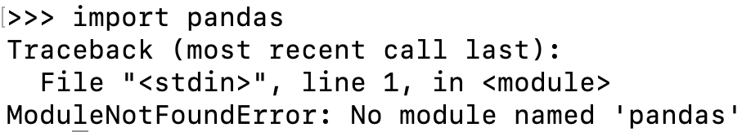
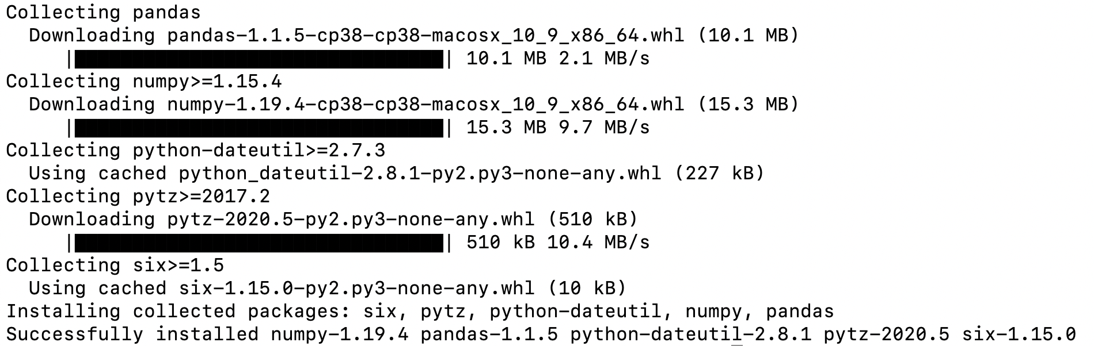
Installing Pandas
Conda / Miniconda:
conda search pandas
conda install pandas
Virtual environment:
pip install pandas

Slide 6
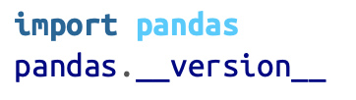

Running Pandas
Importing pandas
Checking the version
Aliasing​

Slide 7
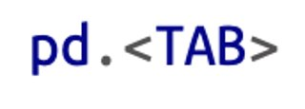
Getting Help

Slide 8
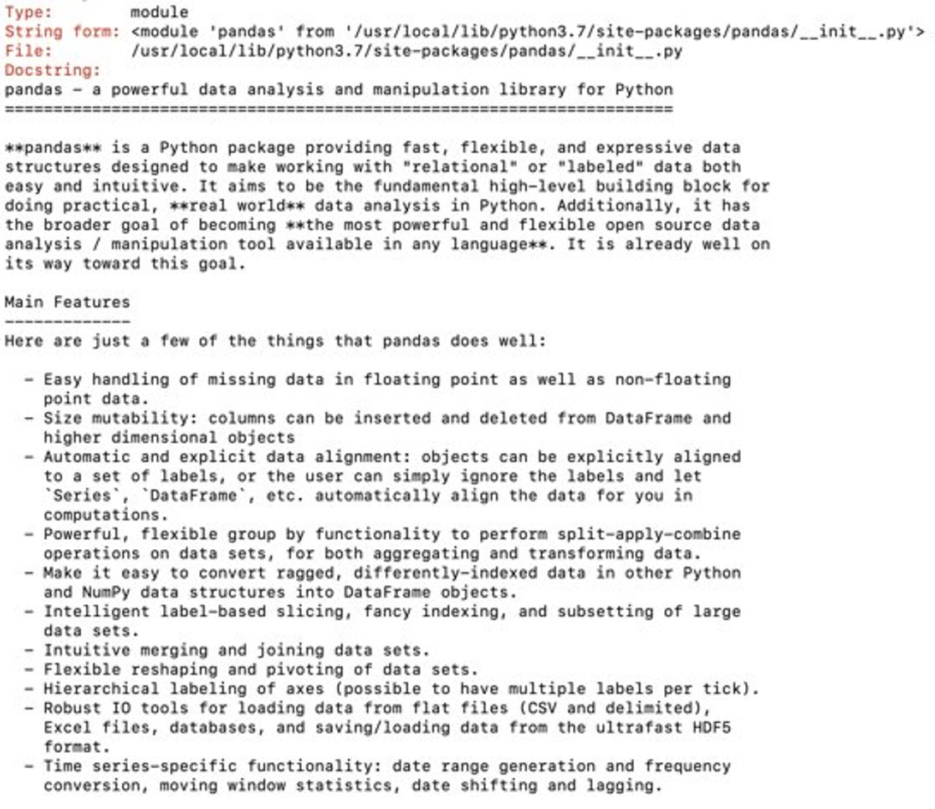
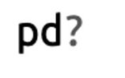
Getting Help

Slide 9
Pandas Objects

Slide 10
Pandas Objects
Objects: NumPy Structured arrays
Pandas Data Structures
- Series
- DataFrame
- Index

Slide 11
Pandas Objects
Series

Slide 12
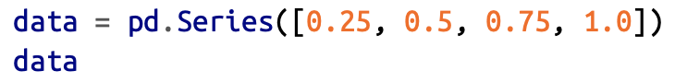


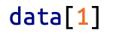
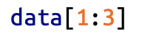
Pandas Series
Series: One dimensional array of indexed data, Created from a list or array
Wraps a sequence of values and a sequence of indices
Can be accessed like an array

Slide 13
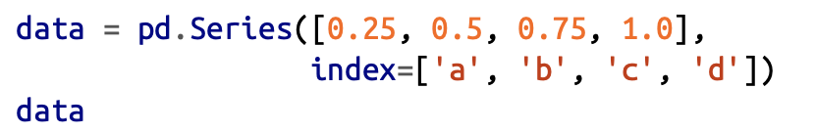
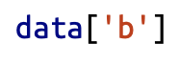
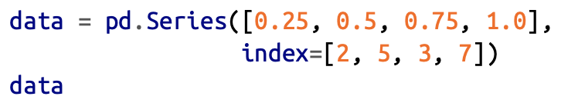
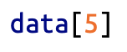
Series as a generalized NumPy arrray
NumPy array: Implicit index
Series: Explicit index
Series Index can be strings
Series Index can be non-continuous integers

Slide 14
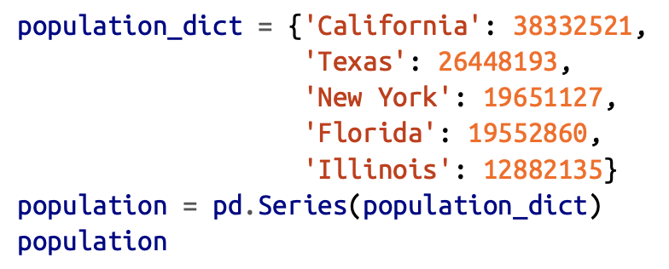
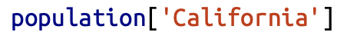
Series as a Dictionary
Series: Mappings from a set of key-typed keys to a set of typed values

Slide 15
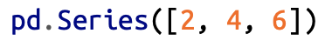
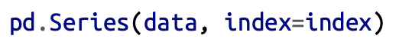
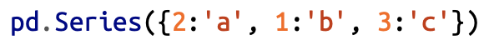
Constructing Series
Constructing Series:
data (required) - list or NumPy array
index (optional)

Slide 16
Pandas Objects
DataFrame

Slide 17
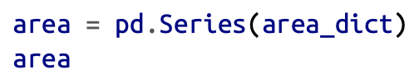
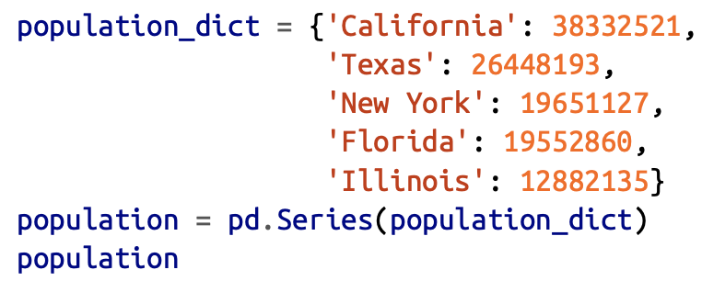
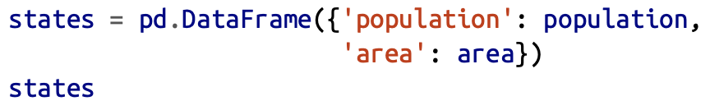


Pandas DataFrame as a NumPy array
DataFrame: Two dimensional array with flexible row indices and flexible column names
A Sequence of aligned (same index) Series Objects

Slide 18
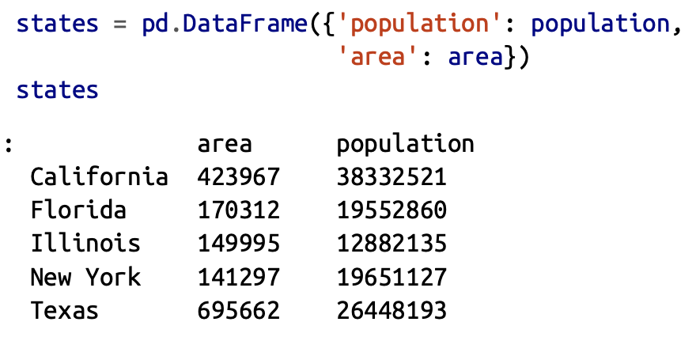
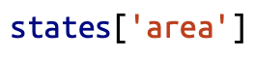
Pandas as a Dictionary
DataFrame: Maps a column name to a Series of column data
NumPy Array
Data[0] --> first row
DataFrame
Data['Col 0'] --> first column

Slide 19
Constructing DataFrames
1. From a Single Series Object
2. From a list of dicts
3. From a dict of Series objects
4. From a 2D NumPy array
5. From a NumPy Structured array

Slide 20
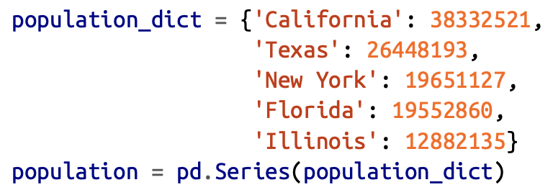
From a Single Series Object
DataFrame is a collection of Series Objects
A Single column dataFrame is constructed with a Single Series Object

Slide 21
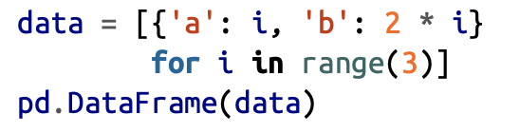
From a list of dicts
DataFrame is a collection of list of dictionaries
DataFrame is constructed with NaN added for some missing values

Slide 22
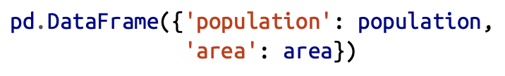
From a dictionary of Series Objects
DataFrame is a collection of dictionary of Series Objects

Slide 23
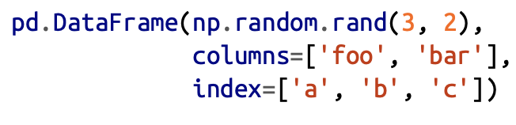
From a 2D NumPy array
Given a 2D NumPy array, a DataFrame can be created with specified columns and index

Slide 24
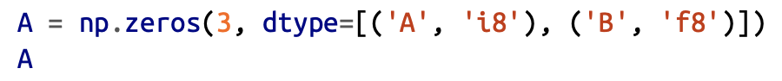
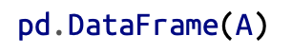
From a NumPy Structured array
Given a NumPy Structured array, a DataFrame can be created directly from it

Slide 25
Pandas Objects
Index

Slide 26
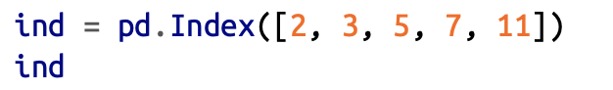
Index Object
Immutable Array
Ordered Set
Index is created using a list of integers

Slide 27


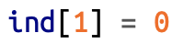
Index as Immutable Array
Index object operates like an array
Familiarity with NumPy arrays
Immutable indices

Slide 28
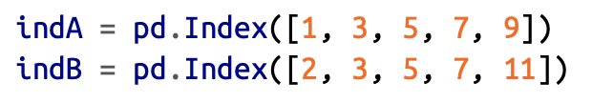



Index as Ordered Set
Index objects are used as joins on datasets
Set operations:
- Union
- Intersection
- Difference
- Symmetric Difference

Slide 29
Data Indexing and Selection

Slide 30
Data Selection
Data Selection
- Series
- Dictionary
- 1D array
- DataFrame
- Dictionary
- 2D array

Slide 31
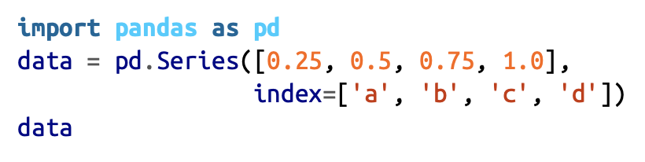
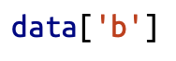
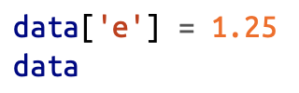
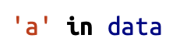
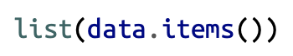
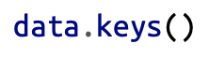
Data Selection in Series as a Dictionary
Mapping from a collection of keys to collection of values
Python-like expressions
Mutability possible

Slide 32
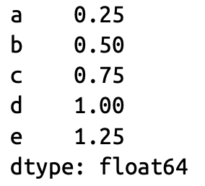
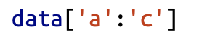
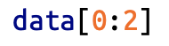
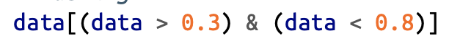
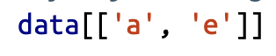
Data Selection in Series as a 1D array
Array-style item selection like
- Slicing
- Explicit index
- Implicit index
- Masking
- Fancy Indexing

Slide 33
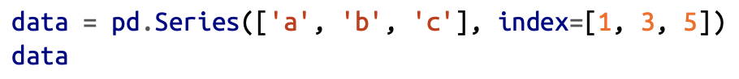
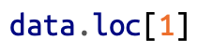
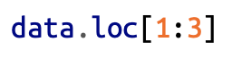
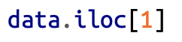
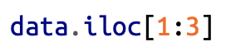
Data Selection in Series as a 1D array
Explicit and Implicit indexing confusion
loc - Explicit indexing
iloc - Implicit indexing

Slide 34
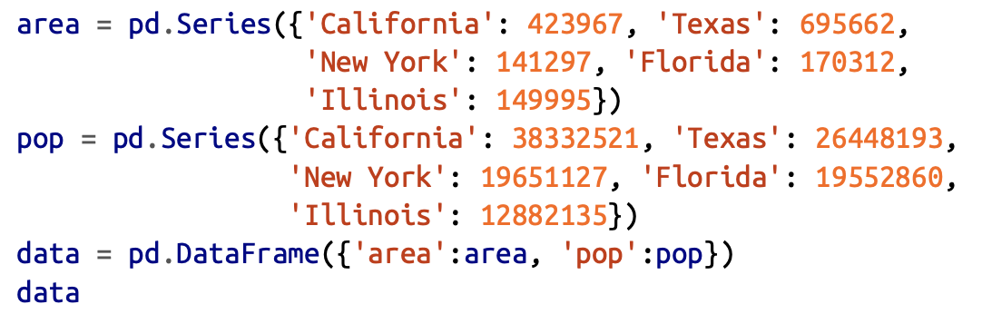

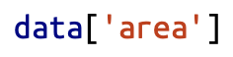



Data Selection in DataFrame as a Dictionary
Mapping from a collection of keys to collection of values

Slide 35





Data Selection in DataFrame as a 2D array

Slide 36




Data Selection in DataFrame
Indexing --> Columns
Slicing --> Rows

Slide 37
Missing Data

Slide 38
Missing Data
Real-world data is not clean and comes with enormous missing values
NaN, None
2 Strategies
- Mask (globally indicate missing value)
- Sentinel value (choose a value to indicate missing value)

Slide 39



Missing Data

Slide 40


Missing Data
isnull()
notnull()
dropna()
fillna()

Slide 41


Detecting null values

Slide 42



Dropping null values
Drop full row or full column

Slide 43





Filling null values
Zero fill
Forward fill
Backward fill

Slide 44
Combining Datasets
Concat and Append

Slide 45



Concat
Concatenation of NumPy arrays

Slide 46



Concat

Slide 47





Duplicate Indices

Slide 48
Combining Datasets
Merge and Join

Slide 49
Merge
pd.merge()
Categories of join
- One-to-one
- Many-to-one
- Many-to-many

Slide 50


One-to-one joins
Simplest join
Column-wise concatenation

Slide 51



Many-to-one joins
One of the two key columns has duplicate entries

Slide 52


Many-to-many joins
If both the key columns has duplicate entries

Slide 53

on Keyword
This works only if both left and right dataframe has the same column name

Slide 54

left_on & right_on
Sometimes, the same column name won't be there in different dataframes.

Slide 55

inner join
intersection

Slide 56
outer join
Returns the join over the union of the input columns, fill all the missing values with NaN

Slide 57
left join
Returns the join over the left entries, fill missing values with NaN

Slide 58


Overlapping Column names
As the column names have conflicts, the join produces two columns with suffixes _x and _y

Slide 59
Aggregation and Grouping

Slide 60

Aggregation
Instant insight for a dataset
- sum
- median
- mean
- min
- max
- describe
- groupby

Slide 61



Planets dataset
Seaborn (visualization library)
- install through pip
- import library
- load dataset

Slide 62

Groupby
Simple aggregation doesn't give away too much
Need to aggregate conditionally on a label or index : Groupby
Groupby
- Split
- Apply
- Combine

Slide 63



Groupby
Groupby on key "key"
Lazy computation
sum() can be replaced with any aggregation method in Pandas or NumPy

Slide 64



Column Indexing
Column Indexing

Slide 65


Iteration Over Groups
Returns each group as a Series or DataFrame

Slide 66



Dispatch Methods
Returns each group as a Series or DataFrame

Slide 67




Aggregate ( )
Input: String, list, function

Slide 68


Filter ( )
Returns a Boolean value specifying whether the group passed the filtering or not

Slide 69
Transform ( )
Returns a transformed version of full data to recombine
Eg: Shifting center with respect to mean

Slide 70


Apply ( )
Input: DataFrame
Output: Pandas object or Scalar

Slide 71
Pivot Tables

Slide 72



Pivot Tables
Input: column- wise data
Groups the entries into a two-dimensional table that provides a multidimensional summarization of the data
Pivot tables: multidimensional version of GroupBy aggregation
That is, you split- apply-combine, but both the split and the combine happen across not a one- dimensional index, but across a two-dimensional grid

Slide 73
Pivot Tables by Hand
Hand computation

Slide 74



Pivot Tables
Options
- aggfunc
- margins
- fillna
- dropna

Slide 75



Case Study: US Birth Dataset
Births Dataset
What do you see?

Slide 76


Case Study: US Birth Dataset

Slide 77


Case Study: US Birth Dataset

Slide 78




Case Study: US Birth Dataset

Slide 79
Strings

Slide 80


Strings
Vectorization

Slide 81





Strings
String Methods

Slide 82

Strings
Regular Expression Methods

Slide 83


Strings
Miscellaneous Methods

Slide 84

Strings
Miscellaneous Methods

Slide 85

Case Study: Recipe Recommender
Parse the recipe data into ingredients list
Given a / a set of ingredients, find all the recipes with it as the ingredient

Slide 86

Case Study: Recipe Recommender
What is the average size of ingredients?
Which recipe has the longest ingredient?
How many breakfast recipes?
How many recipes contain Cinnamon?

Slide 87




Case Study: Recipe Recommender
Simple Recommender

Slide 88
Files

Slide 89

CSV
Reading from a CSV file
Writing to a CSV file

Slide 90
HDF5
Reading from a HDF5 file
Writing to a HDF5 file

Slide 91
EXCEL
Reading from a Excel file
Writing to a Excel file

Slide 92
References and Further Reading
Pandas user guides
https://pandas.pydata.org/pandas-docs/stable/user_guide/index.html
Python for Data Analysis Wes McKinney
Python Data Science Handbook Jake Vanderplas
Pandas Tricks
https://www.dataschool.io/python-pandas-tips-and-tricks/

Slide 93
Task: Covid-19 Data Analysis
https://github.com/CSSEGISandData/COVID-19/tree/master/csse_covid_19_data/csse_covid_19_daily_reports

Slide 94
Covid Analysis
Data Source: https://github.com/CSSEGISandData/COVID-19/tree/master/csse_covid_19_data/csse_covid_19_daily_reports
Field description
Province_State: China - province name; US/Canada/Australia/ - city name, state/province name; Others - name of the event (e.g., "Diamond Princess" cruise ship); other countries - blank.
Country_Region: country/region name conforming to WHO (will be updated).
Last_Update: MM/DD/YYYY HH:mm (24 hour format, in UTC).
Confirmed: the number of confirmed cases. For Hubei Province: from Feb 13 (GMT +8), we report both clinically diagnosed and lab-confirmed cases. For lab-confirmed cases only (Before Feb 17), please refer to who_covid_19_situation_reports. For Italy, diagnosis standard might be changed since Feb 27 to "slow the growth of new case numbers." (Source)
Deaths: the number of deaths.
Recovered: the number of recovered cases.

Slide 95
Covid Analysis
Reading the dataset into a Pandas Dataframe
Finding the Number of Confirmed Cases
Finding the Number of Recovered Cases
Finding the Number of Deaths
Finding the Number of Active Cases
Finding the above Country-wise, Province/State-wise
Plotting these insights

